Slide 1

Geo Query & Proximity Search
Shivendra Pratap Singh
1809710106

Slide 2

Problem: Find a Faster way to query Location in NoSQL Database

Slide 3
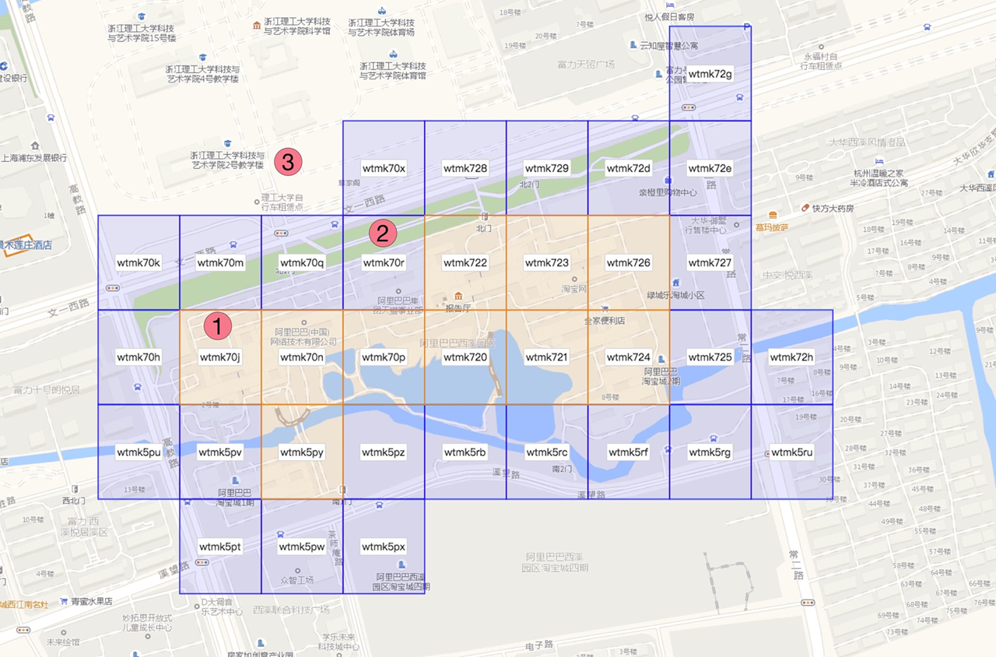
Solution
Using Geo Hash Algorithm by Gustavo,
Using Proximity Search

Slide 4
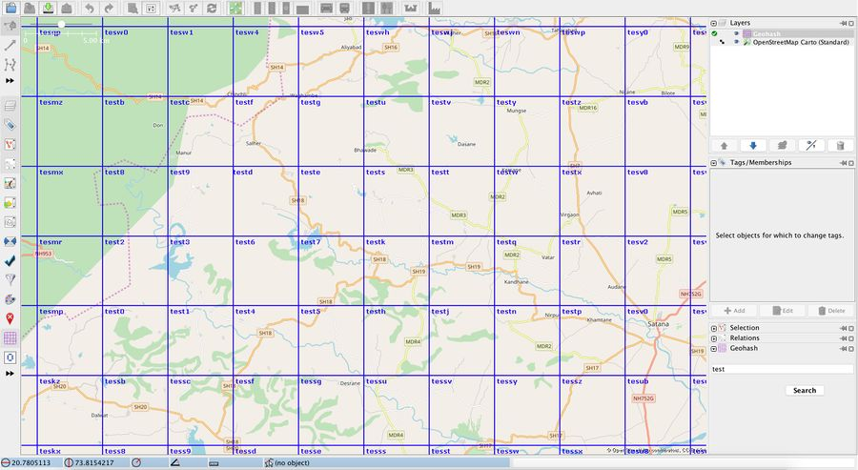
GeoHash
Append Unique Letter to each depth of the sub region

Slide 5
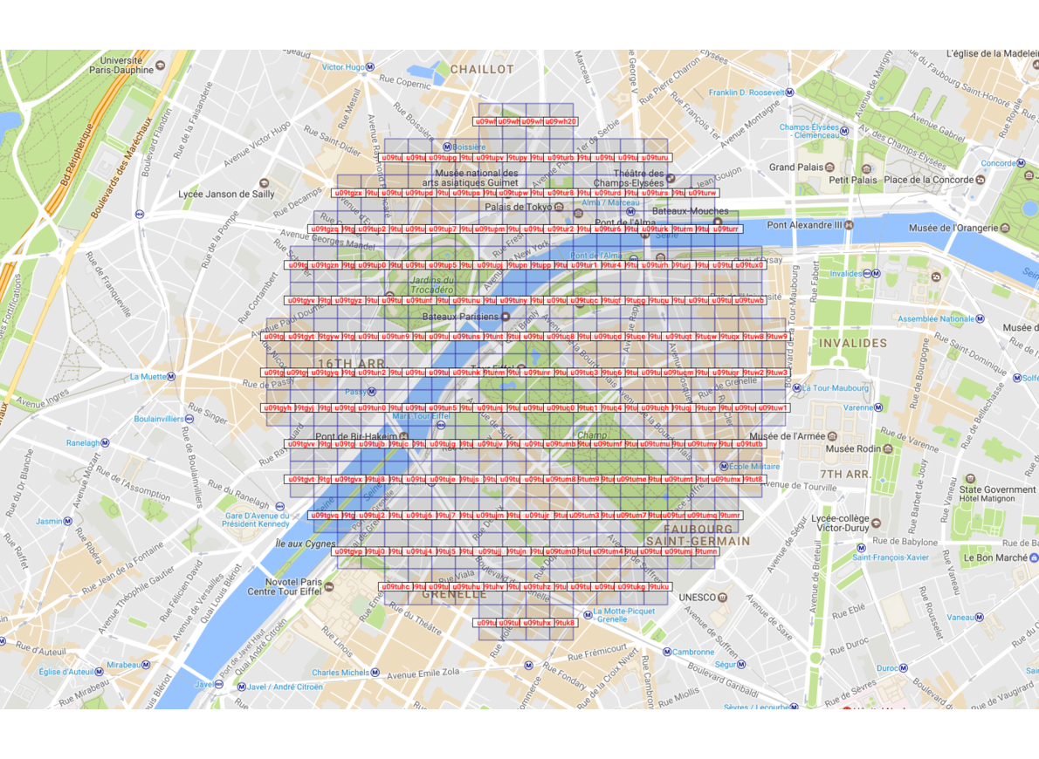
Proximity Search
Generate a proximity region of a given radius

Slide 6
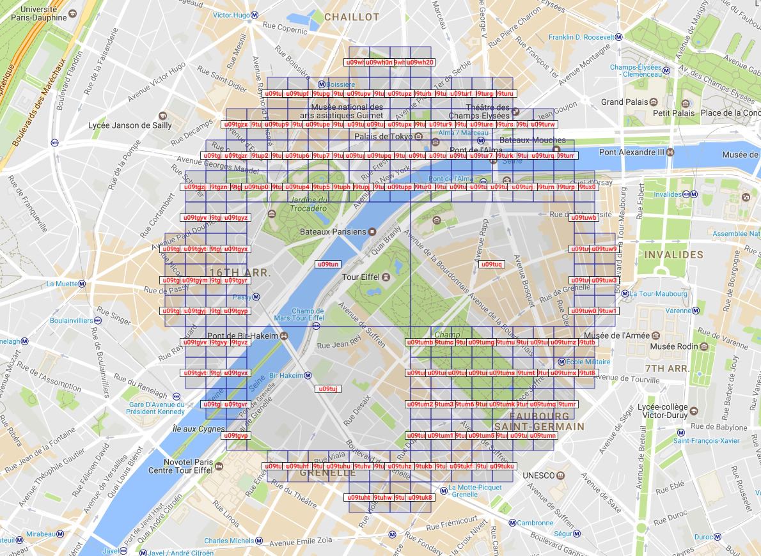
Geohash Compression

Slide 7
Applications
BIG IMAGE
Social Networking - Used by dating apps to find romantic matches within a particular cell, and to create chat apps.
Nearby Searches – Find nearby locations, and identify places of interest, restaurants, shops and accommodation establishments in an area.
Digital Travels – Geohashers go on global expeditions to meet people and explore new places. The twist: the destination is a computer-generated geohash and participants in this turnkey travel experience have to write up and post their story on the internet.
Custom Interactive Apps

Slide 8
Demo

Slide 9
Thank You

Slide 10

THANK YOU!
August Bergqvist
Phone:
678-555-0128
Email:
BERGQVIST@EXAMPLE.COM

